Slide 1
Breaking Out of My Cultural Bubble
Racial Self-Segregation in Cape Town’s Religious Scene

Slide 2
Why is this out of my cultural bubble?
Never considered myself religious, not part of my identity
“Raised atheist” by public school and parents
Never been to church service
Barely a clue of what happens during service
Even though I don’t consider myself religious, I don’t hold prejudice against those that do. They have found faith, while I have not found mine. And it’s nice to have faith. Faith is a beautiful human emotion.

Slide 3
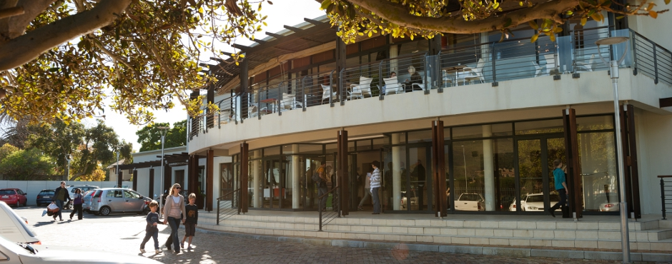
Common Ground Rondebosch

Slide 4
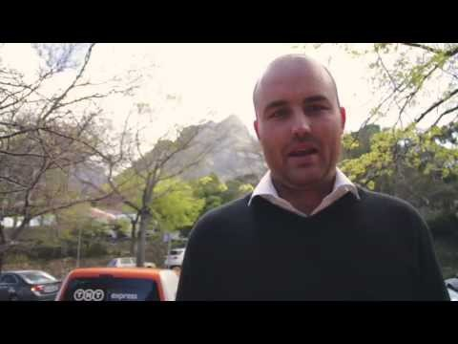

Slide 5
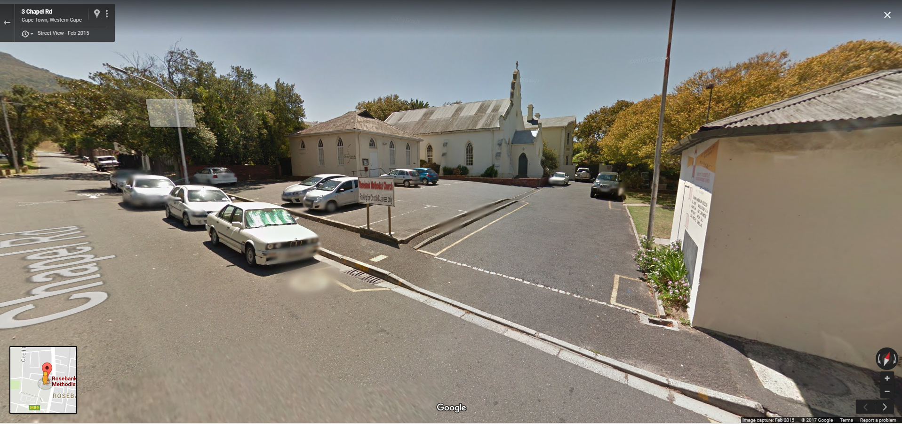

Slide 6
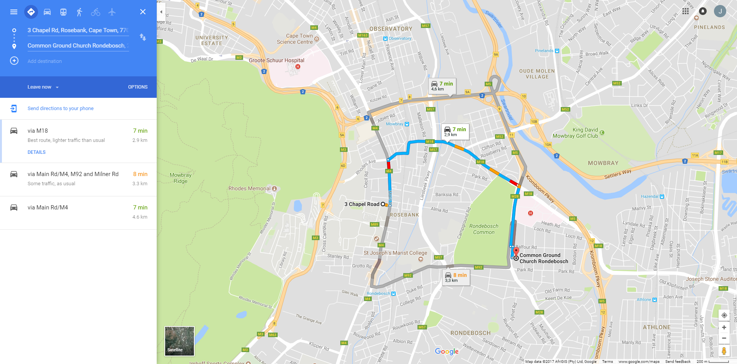

Slide 7
Takeaways
Religion has been influenced by heritage, history, and tradition
Inequality still exists within an open and accepting environment that preaches the antithesis
Segregation still exists within Cape Town’s religious scene
Segregation seems to be purposeful, intentional, accepted, welcomed, and tolerated despite the inequality
Racial self-segregation
Has Apartheid and post-Apartheid conflict influenced today’s lack of diversity in various church services?

Slide 8
Articles
Anti-apartheid website with an article describing the intersectionality of the apartheid era and religion
Dutch were first European settlers in 17th century
1652 - Jan van Riebeck formally establishes the Dutch Reformed Church, became a major power
Since its creation, church has been in support of the white-Afrikaner community and its political agenda
Pro-apartheid
Mixing races in religious setting was sinful
Made separate churches for non-whites

Slide 9
Articles
During apartheid regime, certain individuals within South Africa’s religious communities, like Anglican Archbishop Desmond Tutu, rose to power in the anti-Apartheid movement as a result of their religious beliefs
Individuals expressed support for democratic change in South Africa and contempt for segregation and racism
Desmond Tutu: “Faith is a highly political thing. As followers of God we too must be politically engaged”
Anti-apartheid activists believed apartheid was morally and ethically unjustifiable, inhumane, cruel, and a sin. Opposite of what the DRC believed.

Slide 10
Articles
DRC expelled form the World Alliance of Reformed Churches in early1980’s for unwavering apartheid support
1986 – Church shows repentance by preaching for all members of all racial groups to unify and pray under one common institution
1996 - Racial divides still exist within the church post-apartheid
Dutch Reformed Church – 1,288,837 members (whites)
Uniting Reformed Church - 1,216,252 members (coloured/blacks)
Reformed Church - 2,386 members (Indian)
2017 – DRC considers apartheid a sin in hope of reunifying its congregants on the basis of belief as opposed to race

Slide 11
Conclusion
Self-segregation is not a myth, instead it is a social phenomena
Despite engaging in political activism and fighting against religious segregation for its sinful nature, South Africans continue to racially self-segregate.
Self-imposed segregation in religion is a parallel between the United States and South Africa. Both Countries have traditionally white or black churches, neighbourhoods, etc.

Slide 12
Conclusion
At the end of the day, people like familiarity
This gives them comfort and, to a degree, a sense of security. As just about every individual seeks these things, natural segregation is the result
Segregation still takes place, be it by nationality, race, religion and even disability

